Slide 1
Preventive Drug Education
The Essentials to Help You Champion a Drug-Free Singapore

Slide 2
SINGAPORE’S DRUG POLICY
Why Singapore is Tough on Drugs
CNB aims to create a drug-free society where our people can work, live and play safely
Our strict laws are an effective deterrent, ensuring harmful drugs are kept out of easy reach of most people
Drug abuse harms the abuser, those around him and has larger implications on society. It is never a personal choice
Singapore is not immune to external influence and the global movement for drug legalisation/decriminalisation. We cannot allow drugs to take hold of our society
Thus we need your help to spread the anti-drug message in your circles of influence and get our community to stay resilient against drug abuse

Slide 3
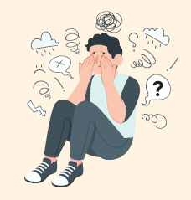
THE DRUG SITUATION IN SINGAPORE
Our local situation remains stable currently – but we cannot take this for granted
A worrying trend is the increasing cannabis consumption among abusers below the age of 30
In particular, we need to educate and protect our youths, who
Cite stress, curiosity and external influence as common reasons for taking drugs
Have a more permissive attitude toward drugs
Are more willing to experiment with cannabis
May fall prey to misinformation on the internet

Slide 4
SINGAPORE’S DRUG LAWS
The Misuse of Drugs Act 1973
It is an offence* to:
Traffick controlled drugs
Depending on the drug class and quantity, the penalty ranges from imprisonment and caning to the mandatory death penalty
Consume controlled drugs outside of Singapore
Possess drug paraphernalia
Possess and consume controlled drugs
If found to be in possession, one shall be liable for imprisonment of up to 10 years, or a fine not exceeding S$20,000, or both
Allow and facilitate drug activities
*The above list of offences is not exhaustive

Slide 5
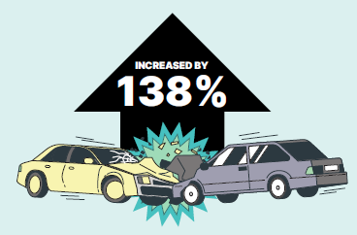
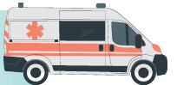
WHAT IF SINGAPORE LEGALISES DRUGS?
The Need for our Zero-Tolerance Stance
Research has shown that in countries that have legalized drugs, there have been:
Increased drug abuse with higher frequency and substance potency
Increased rates of homelessness and other crimes
Widespread impacts on public health, the rule of law and general social harm
In Colorado, it was noted that after recreational cannabis was legalised, traffic deaths where drivers were tested positive for cannabis increased by 138%.
In Thailand, there were reports of teenagers hallucinating and harming themselves after smoking cannabis.

Slide 6
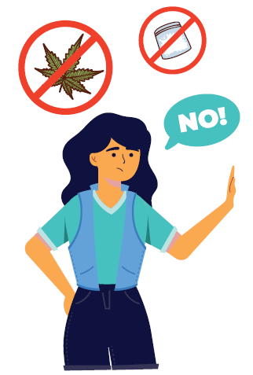
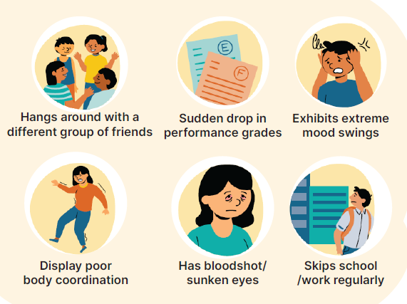
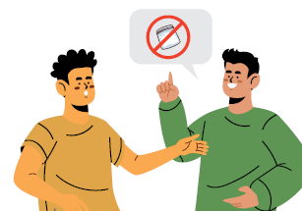
HOW TO HELP THE PEOPLE AROUND YOU
Using the R.I.S.E model
Start a conversation
Teach Refusal skills
Look out for Indicators
Engage people meaningfully
E.g. news stories, managing stress healthily
E.g. healthy activities that involve one in a group setting positively
E.g. walking away, being firm and bold

Slide 7
HOW TO HELP
If you…
Suspect someone is involved in drug activities
See someone abusing drugs
Come across suspected drug items
You should…
Avoid interacting with that individual
Refrain from handling the items any further
Contact CNB at 1800-325-6666. In case of any immediate danger, call the Police
CONTACT
FOR WHO?
Central Narcotics Bureau
1800-325-6666
Those who wish to report cases of suspected drug abuse
Singapore Anti-Narcotics Association
https://talk2sana.com/tools-for-change/live-chat/
Those who wish to talk to para-counsellors about drug-related issues that you or someone close to you might be facing

Slide 8
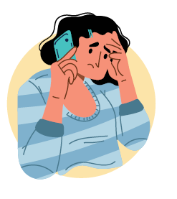
MAKING A REPORT TO CNB
What happens if you report a family/friend?
You will be asked to provide some details so that officers can assess the case
CNB will make an informed assessment and take early intervention and appropriate measures to assist you
What happens after your family/friend is arrested?
The person will be brought back to CNB or the police station for investigation
If suspected to be a drug abuser, he/she will be subjected to an Instant Urine Test or hair test and interview by a CNB officer

Slide 9
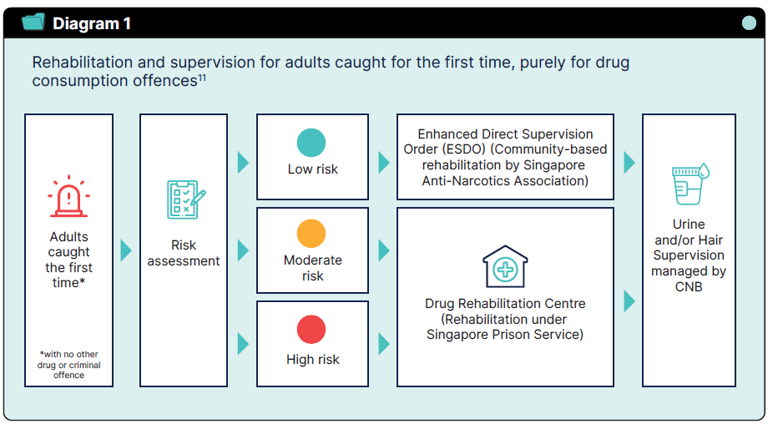
PATHWAYS OF RECOVERY
Drug abusers may be placed on the Drug Supervision Scheme or admitted to the Drug Rehabilitation Centre (DRC) for treatment and rehabilitation
The pathways of recovery depend on the abusers’ assessed risk of reoffending

Slide 10
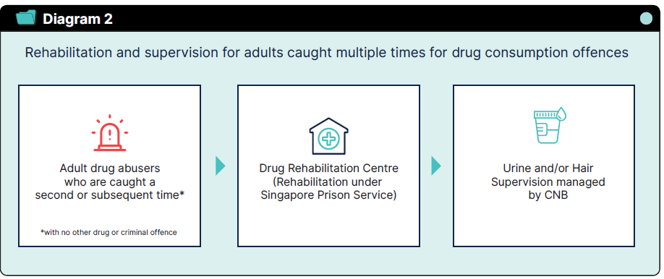
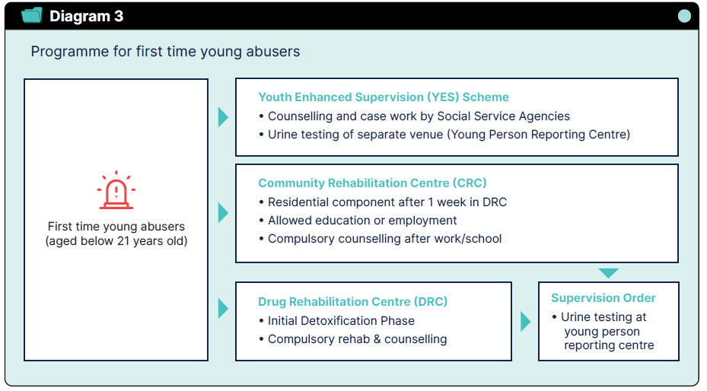
PATHWAYS OF RECOVERY

Slide 11
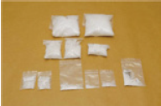
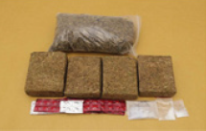
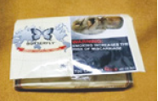
COMMONLY ABUSED DRUGS AND THEIR EFFECTS
Methamphetamine
Cannabis
New Psychoactive Substances
a.k.a. Ice, Glass, Speed, Ya Ba, Shabu
a.k.a Marijuana, Weed, Grass, Joints, Ganja, Hashish
a.k.a Spice, K2, Bath Salts, Kronic, and Bromo-Dragonfly
Usually a colourless and odourless crystal that resembles glass fragments or shiny white "rocks"
Also comes in tablet form
Resembles dried herbs or tea leaves. Can be hidden in food products
Contains tetrahydrocannabinol, a chemical that affects one’s mood and the way one sees and hears things
Substances that mimic the effects of controlled drugs
Have unknown, dangerous toxicology effects and are as addictive and harmful as controlled drugs
Fits, stroke and death
Damage to heart and nerves
Liver and kidney diseases
Abnormal behaviour with mood swings, confusion, delusion and hallucination
Anxiety and irritability
Inability to concentrate
Distorted thinking and perception
Slow reaction, poor balance and co-ordination
Extreme anxiety, depression, confusion and paranoia
Severe intoxications
Paranoia and hallucination
Adverse cardiovascular problems
Renal failure
Seizures

Slide 12
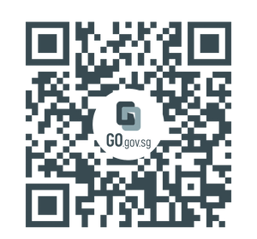
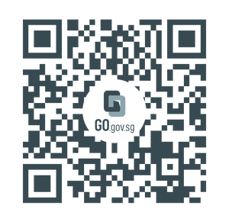
RESOURCES
Get drug-related information
CNB's website
Drugs and Inhalants
Misuse of Drugs Act 1973
Watch educational videos here
CNB's YouTube
PDE Video: #TheStruggle
PDE Video: Last Days

Slide 13
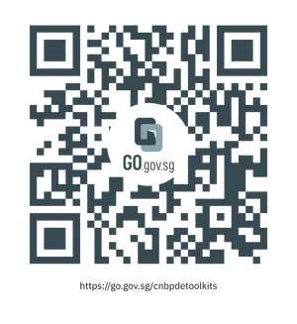
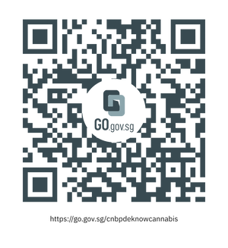
RESOURCES
Learn tips here
Smart Parenting articles
PDE toolkits
PDE message cards
Information booklet on Cannabis
Information booklet on New Psychoactive Substances (NPS)

Slide 14
Thank you.
We hope you find this set of resources useful.
Let’s work together towards a drug-free society!

